Slide 1
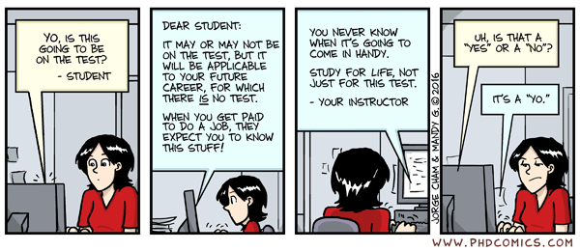
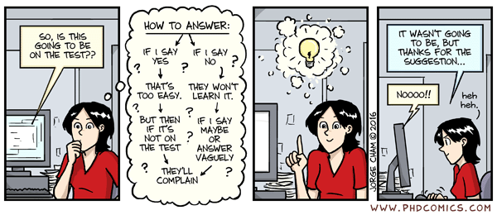

Slide 2

CSE 102 - COMPUTER PROGRAMMING II Midterm Information
Joseph LEDET
Department of Computer Engineering
Akdeniz University
josephledet@akdeniz.edu.tr

Slide 3
Outline
Exam format
Review material
Questions

Slide 4
DATE/TIME/LOCATION
Date
Friday 19-April-2024
Time
09:00 - 10:30
Location
Amfi4, BB01

Slide 5
GRADING INFORMATION
100 points
Represents 20% of Final grade

Slide 6
Topics Covered
All topics discussed in class up to Week 8
Object-oriented Thinking
Inheritance and Polymorphism
Basic UML
Exceptions
Testing
Abstract classes and Interfaces
Topics from previous courses
Programming basics
Data types
Control structures (if statements/loops)

Slide 7
Format
Quick Answer Questions
Multiple Choice
True/False
Matching
Program Flow
What is the output of a loop/method?
What is the return value of a method?
Will an Exception occur?
Implement a System/Class/Method
UML diagram
Write code

Slide 8
Multiple choice
What will be the value of the following expression?
1 + 2 * 3 / 4
1
2
2.25
2.5
None of the above

Slide 9
Multiple choice
In java a class that we create will have how many parent classes?
At least one parent class
Exactly one parent class
2 – a mother and a father
Unknown since we can have as many parents that we want
None of the above

Slide 10
True/False
always
A method must always return a value. -> false
The methods println() and next() are useful methods for displaying output to the screen and gaining input from the user and can be used in a program using the System.out and Scanner classes, respectively. -> true
!true -> false
i++ == ++i -> evaluates as false
++i == i++ -> evaluates as true

Slide 11
Matching
Item | Definition
1) /* | A. Logical AND
2) && | B. Begins a comment
3) // | C. Test for equality
4) = | D. Assigns a new value
5) ==

Slide 12
What is the output?
Able to tell what the value of a variable will be at various points
Able to tell program flow through
if-else statements
Loops
Exceptions
finally always executes

Slide 13
Short program fragment
Write a short fragment to do some task
Know how to
Write a method
Use recursion or iteration
Throw an exception
Use the methods (including constructors) of a parent class

Slide 14
Develop a System
Determine sub-problems
Draw the UML diagram
Implement in Java code
Example
A Store that has Products, and Customers

Slide 15
FINAL NOTE
Closed
Book
Notes
Phone
Computer
Electrical Devices
Mouth
Open
Mind
1 “Notes Sheet” is allowed
Size A-4 paper (1)
Must be handwritten
Anything printed/photocopied will be taken

Slide 16
Questions
[?]

